Slide 1
Innovación con ERP
Víctor García Murillo

Slide 2
empresa
01
ERP
02
Índice
03
Ventajas e inconvenientes del ERP
Tipos de empresas
04
Presentación de la empresa
ERP y sus características
Empresas a las que va dirigido el ERP

Slide 3

01
Presentación de la empresa

Slide 4
Empresa
Solución
La empresa que represento se especializa en el desarrollo web para otras empresas. Actualmente nos encontramos ante un desafío significativo en relación con la contabilidad y la gestión de la información financiera.
Venus has a beautiful name and is
the second planet from the Sun. It’s
terribly hot—even hotter than
Mercury. It’s extremely poisonous

Slide 5
02
ERP escogido

Slide 6
Sage
Software para la gestion empresarial

Slide 7
Modulos disponibles
Personalización
Servicios Cloud
Contabilidad y gestion
Recursos humanos y nominas
Tesorería
Asesorías y despachos
Se pueden hacer pequeñas personalizaciones dependiendo de las necesidades de cada empresa. Se puede personalizar, la interfaz, informes, documentos de compras y ventas y bases de datos.

Slide 8
Usuarios
Tipo de empresas
Depende de del producto, Sage puede ofrecer diversos servicios para 1 usuario, 5 o hasta 20 usuarios.
Esta dirigida a pequeñas y medianas empresas, así como a asesorías y despachos.

Slide 9
Sage 50
Sage Active
Precios
Sage 200
Sage HR
Essential (45 €/mes)
Standard (108€/mes)
Premium (160€/mes)
35 €/mes por usuario
30 €/año por usuario
9 €/mes por usuario
o
150 €/mes

Slide 10

03
Ventajas y desventajas

Slide 11
Ventajas
Centralización
Acceso en tiempo real
Interfaz
Escalabilidad
Operaciones y datos centralizados en una plataforma
Porporciona información y operaciones en tiempo real
Interfaz amigable unida a un soporte de calidad
Facil y rapido de implementar y escalar

Slide 12
Desventajas
Curva de aprendizaje
Dependencia
Versión básica
Personalización
La curva de aprendizaje es pronunciada
Depende de la infraestructutra tecnologica de la empresa
La versión básica tiene muchas limitaciones
Pocas opciones de personalización

Slide 13
Gracias Por su atención
Víctor García Murillo

Slide 14
SWOT
Strengths
Opportunities
Weaknesses
Threats
Despite being red, Mars is actually a very cold place
Jupiter is the biggest planet in the Solar System
Mercury is the closest planet to the Sun
Saturn is composed mostly of hydrogen and helium

Slide 15
Contents of this template
Here’s what you’ll find in this Slidesgo template:
A slide structure based on a pitch deck presentation which you can easily adapt to your needs. For more info on how to edit the template, please visit Slidesgo School or read our FAQs.
To view this template with the correct fonts in ppt format, download and install on your computer the fonts that we have used. You can learn how to download and install fonts here.
An assortment of infographic resources that are suitable for use in the presentation can be found in the alternative resources slide.
A thanks slide, which you must keep so that proper credits for our design are given.
Two resources slides, where you’ll find links to all the elements used in the template.
Instructions for use.
Final slides with:
The fonts and colors used in the template.
A selection of illustrations. You can also customize and animate them as you wish with the online editor. Visit Storyset to find more.
More infographic resources, whose size and color can be edited.
Sets of customizable icons of the following themes: general, business, avatar, creative process, education, help & support, medical, nature, performing arts, SEO & marketing, and teamwork.
You can delete this slide when you’re done editing the presentation.

Slide 16
Table of contents
01
Problem vs. Solution
03
Market & Competition
02
Product
04
Business Model
Topic of the section
Topic of the section
Topic of the section
Topic of the section

Slide 17
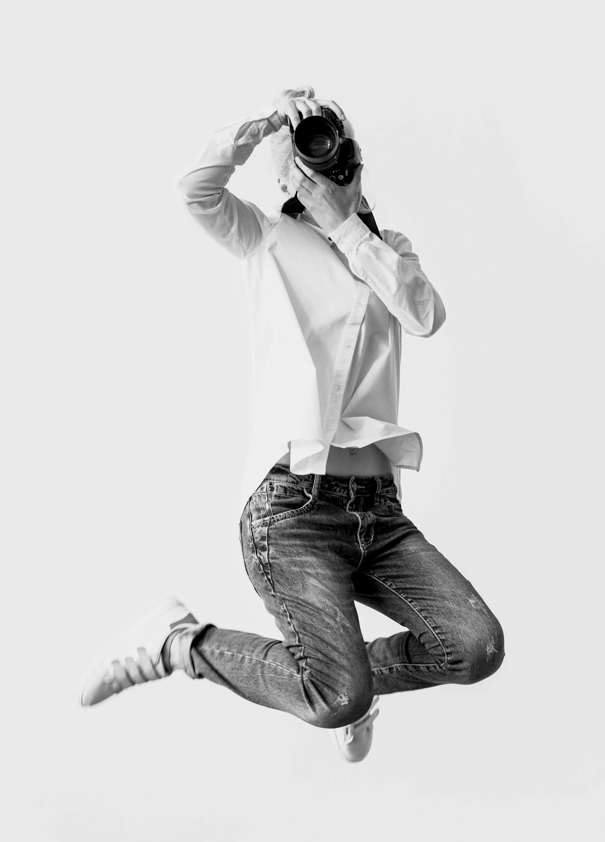
Introduction
Mercury is the closest planet to the Sun and the smallest one in the Solar System—it’s only a bit larger than the Moon. The planet’s name has nothing to do with the liquid metal

Slide 18
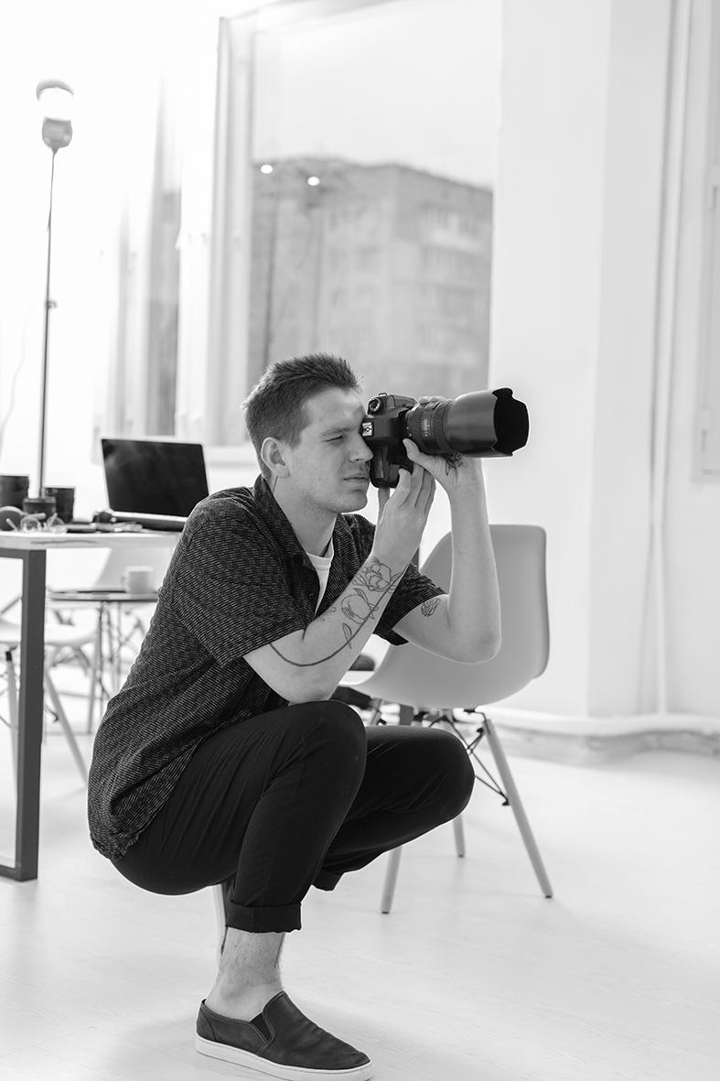
Introduction
Mercury is the closest planet to the Sun and the smallest one in the Solar System—it’s only a bit larger than the Moon. The planet’s name has nothing to do with the liquid metal

Slide 19
Our company
Do you know what helps you make your point clear? Lists like this one:
They’re simple
You can organize your ideas clearly
You’ll never forget to buy milk!

Slide 20
Our company
Do you know what helps you make your point clear? Lists like this one:
They’re simple
You can organize your ideas clearly
You’ll never forget to buy milk!

Slide 21
Our evolution
2010
2005
Jupiter is the biggest planet in the Solar System
Venus has a beautiful name, but it’s terribly hot

Slide 22
Our evolution
2015
2020
Despite being red, Mars is a cold place, not hot
Jupiter is a gas giant and the biggest planet

Slide 23
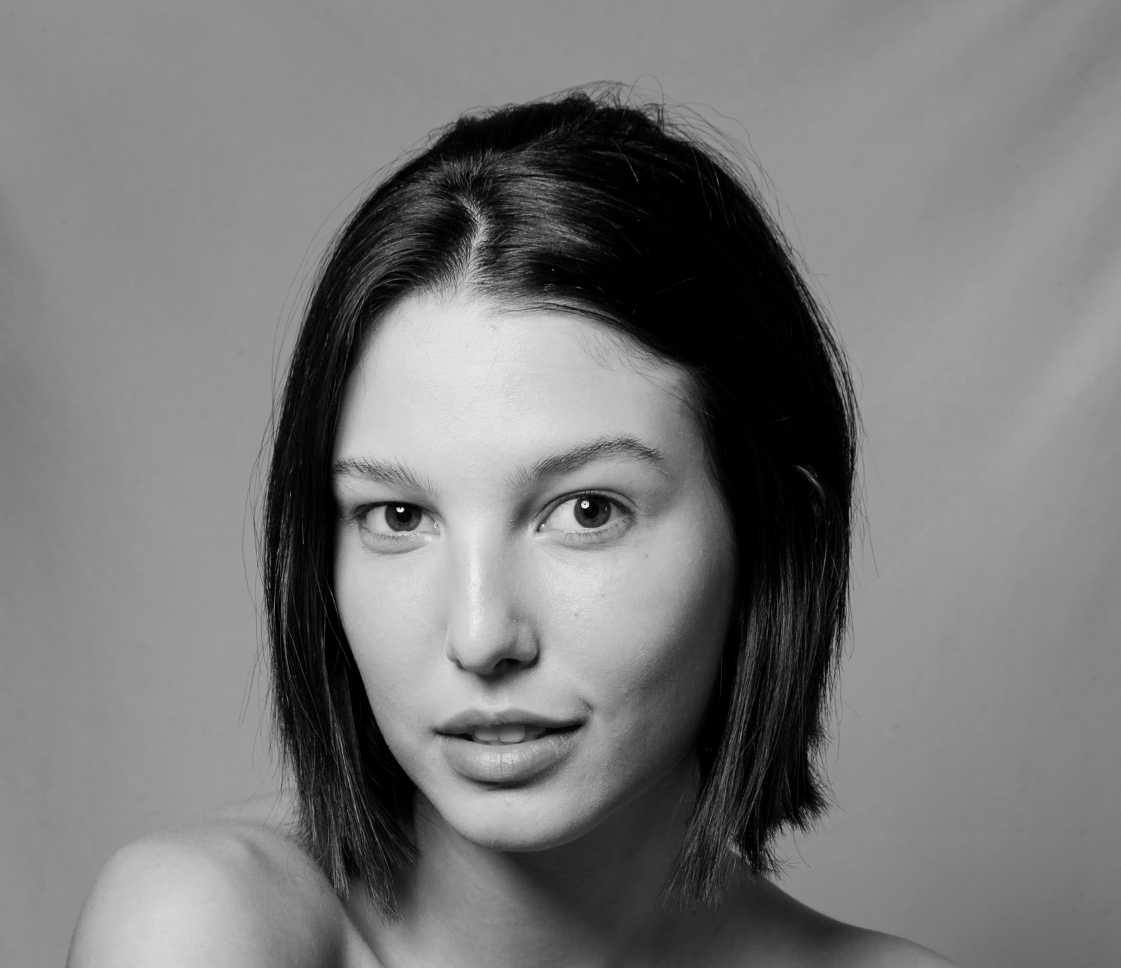
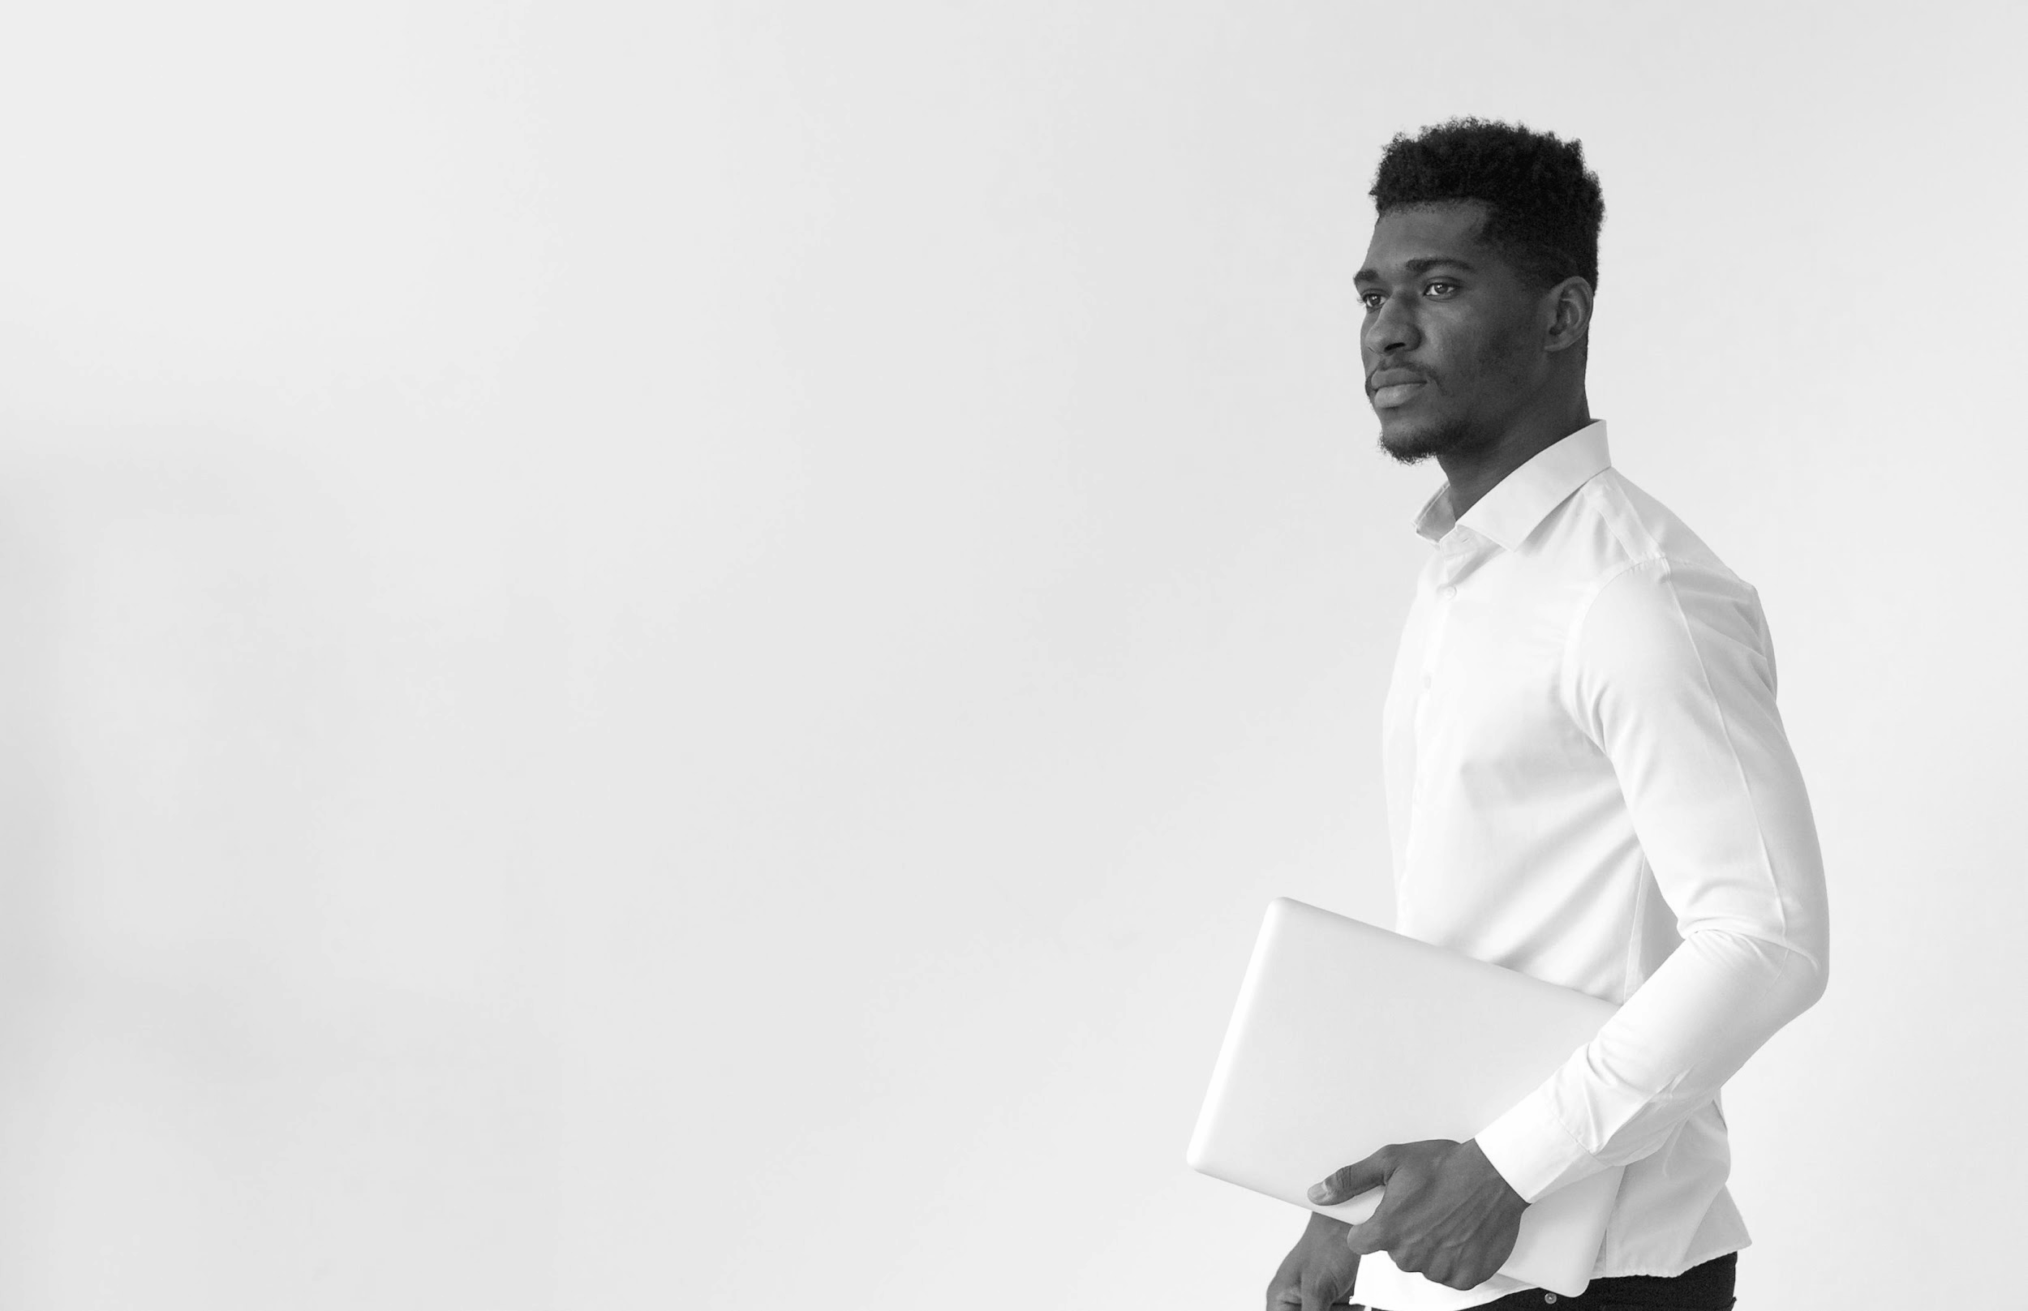
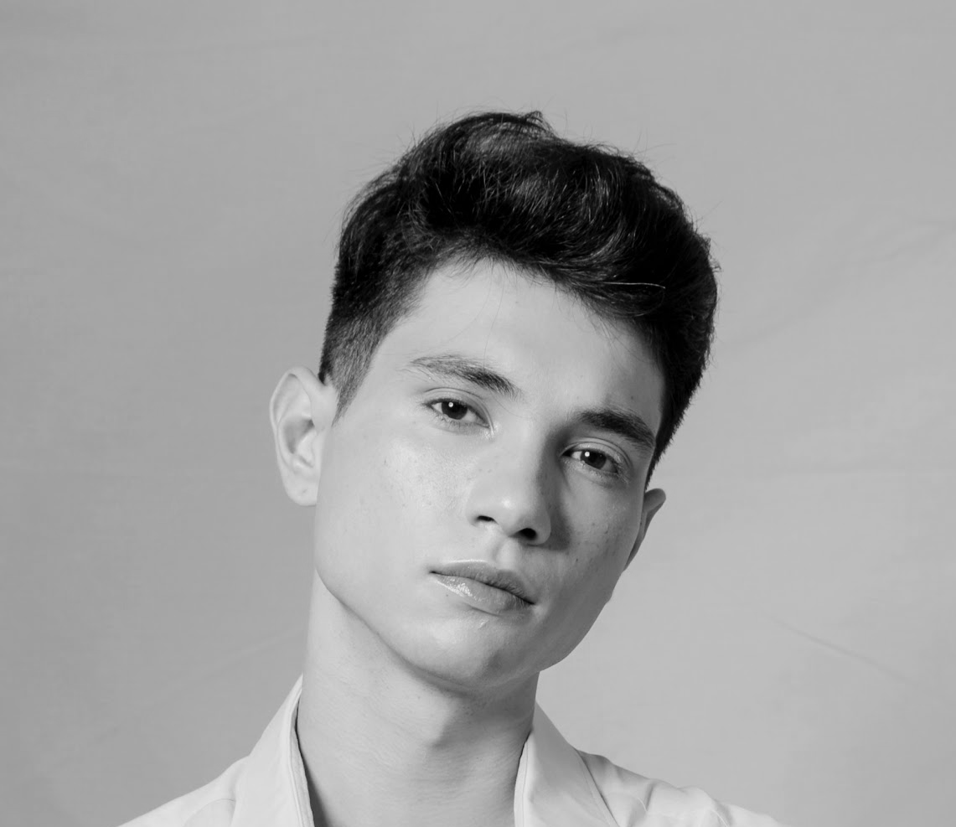
Our team
Lyssa Turner
Peter Rose
John Dublin
You can replace the
image on the screen
with your own
You can replace the
image on the screen
with your own
You can replace the
image on the screen
with your own

Slide 24
Them
Us
Mercury is the closest planet to the
Sun and the smallest one in the
Solar System. Mercury’s name has nothing to do with the liquid metal
Venus has a beautiful name and is
the second planet from the Sun. It’s
terribly hot—even hotter than
Mercury. It’s extremely poisonous

Slide 25
Them
Us
Mercury is the closest planet to the
Sun and the smallest one in the
Solar System. Mercury’s name has nothing to do with the liquid metal
Venus has a beautiful name and is
the second planet from the Sun. It’s
terribly hot—even hotter than
Mercury. It’s extremely poisonous

Slide 26
Solution
Mercury is the closest planet to the Sun and the smallest one in the Solar System. The planet’s name has nothing to do with the liquid metal

Slide 27
Solution
Mercury is the closest planet to the Sun and the smallest one in the Solar System. The planet’s name has nothing to do with the liquid metal

Slide 28

An image is worth a thousand words
Images reveal large amounts of data, so remember: use an image instead of a long text

Slide 29

An image is worth a thousand words
Images reveal large amounts of data, so remember: use an image instead of a long text

Slide 30
AWESOME WORDS

Slide 31
Awesome words

Slide 32

A picture is worth a thousand words

Slide 33

A picture is worth a thousand words

Slide 34
Strengths
Opportunities
SWOT
Weaknesses
Threats
Despite being red, Mars is actually a very cold place. It’s full of iron oxide dust
Jupiter is a gas giant
and the biggest planet
in the Solar System
Mercury is the closest planet
to the Sun and the smallest
one in the Solar System
Saturn is a gas giant,
composed mostly of
hydrogen and helium

Slide 35
SWOT
Strengths
Opportunities
Weaknesses
Threats
Despite being red, Mars is actually a very cold place
Jupiter is the biggest planet in the Solar System
Mercury is the closest planet to the Sun
Saturn is composed mostly of hydrogen and helium

Slide 36
Strategy
Goal
Key Action 1
Key Action 2
Venus
Mars
JUPITER
Mercury
Saturn is a gas giant with rings
Neptune is far away from Earth
Venus has a beautiful name
Despite being red, Mars is a cold place
Jupiter is the biggest planet
Mercury is the smallest planet

Slide 37
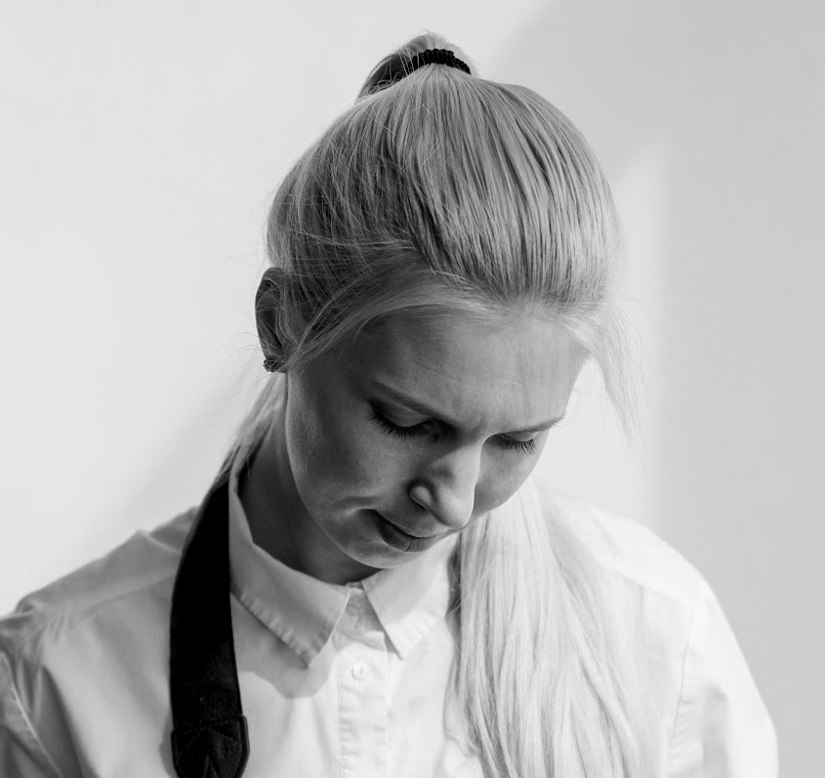
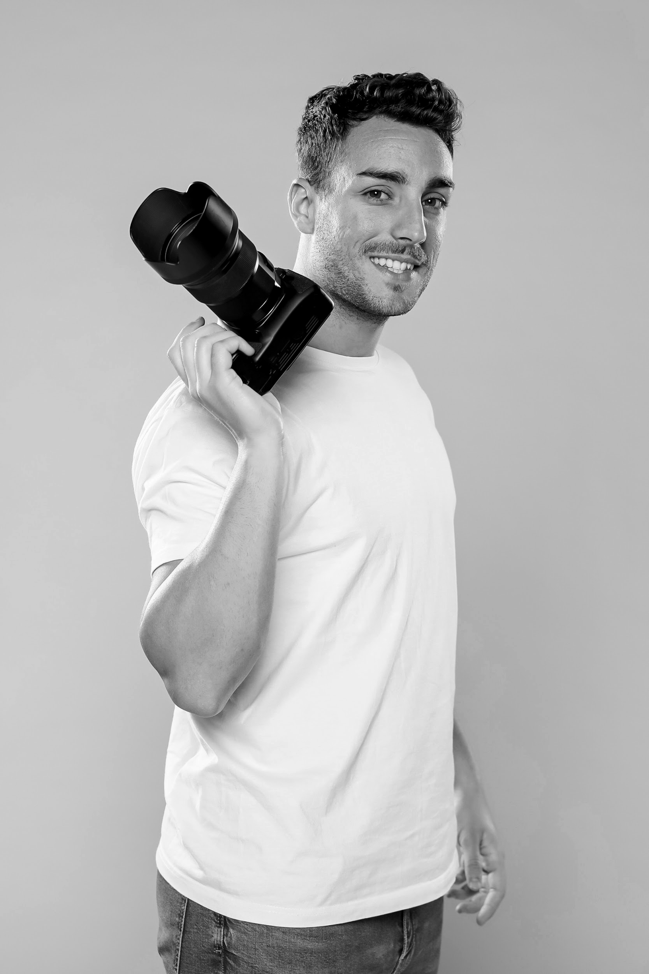
Our services
Planning
Photography
Venus is the second planet from the Sun
Saturn is a gas giant and has several rings

Slide 38
Our plans
Basic
Pro
Premium
Despite being red, Mars is actually cold place
Saturn is composed mostly of hydrogen and helium
Jupiter is a gas giant and the biggest planet

Slide 39
BASIC
Our plans
PRO
PREMIUM
Despite being red, Mars is actually cold place
Saturn is composed mostly of hydrogen and helium
Jupiter is a gas giant and the biggest planet

Slide 40
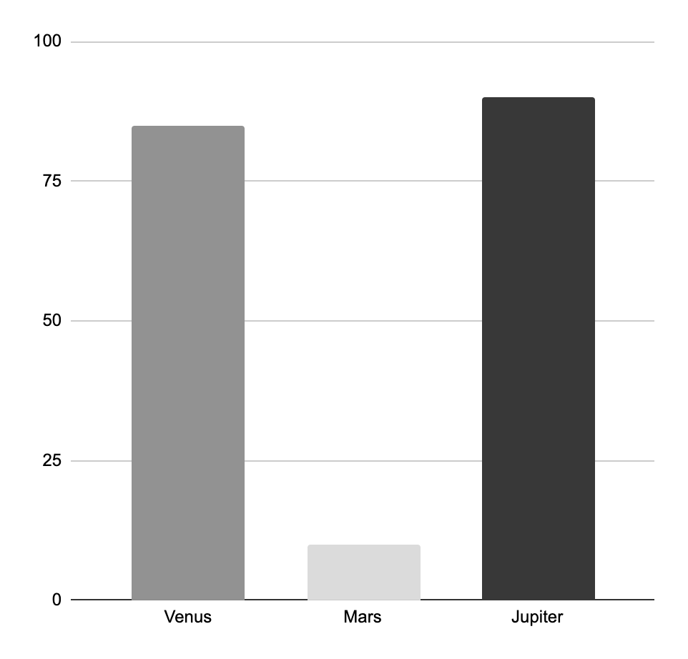
Trend
People
90%
458K
Mercury is a small planet
85%
Neptune is an ice giant
Sales
$7,520,000
Mars is a very cold place
Uranus is an ice giant
Market
10%
86%
Jupiter is a gas giant
Mars is a very cold place
Follow the link in the graph to modify its data and then paste the new one here. For more info, click here

Slide 41
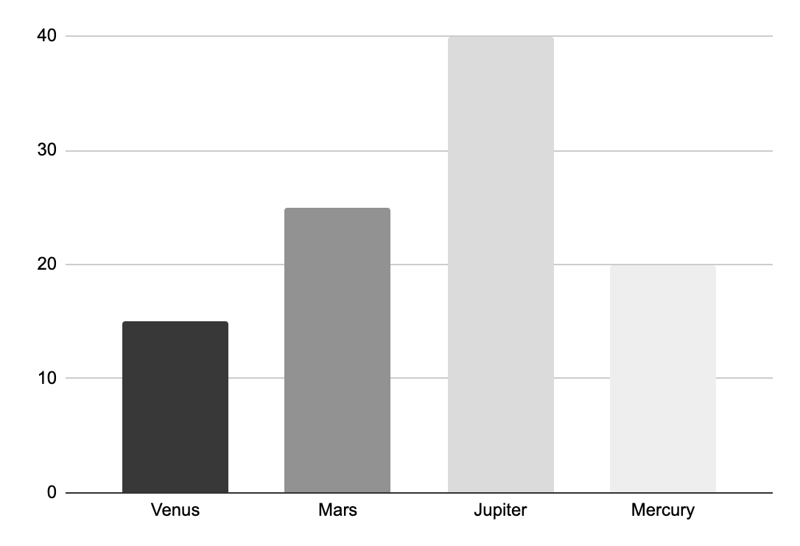
Trend
Venus
Jupiter
Venus has a nice name
Jupiter is a gas giant
Mars
Mercury
Mars is a very cold place
Mercury is a small planet
Follow the link in the graph to modify its data and then paste the new one here. For more info, click here

Slide 42

Product demo
Insert your multimedia content here

Slide 43
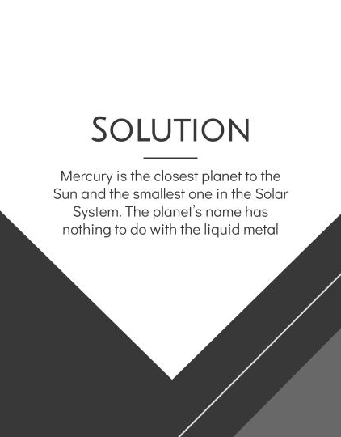
Product demo
Insert your multimedia content here

Slide 44

Case study
Challenge
Results
Solution
Despite being red, Mars is a cold place. It’s full of iron oxide dust
Jupiter is a gas giant and the biggest planet in the Solar System
Venus has a beautiful name and is the second planet from the Sun

Slide 45
Case study
PROBLEM
RESULTS
CHALLENGE
SOLUTION
Despite being red, Mars is actually a very cold place
Venus has a beautiful name but it’s terribly hot
Jupiter is a gas giant and the biggest planet
Mercury is the closest planet to the Sun

Slide 46
Reviews
Helena James
Jenna Doe
John Smith
Jessica Jones
Peter Harris
Maria Wilson
Mercury is the smallest planet
Venus has a very beautiful name
Despite being red, Mars is cold
Jupiter is the biggest planet of them all
Saturn is a gas giant with several rings
Neptune is far away from Earth

Slide 47


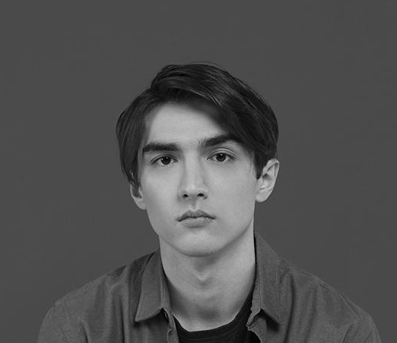
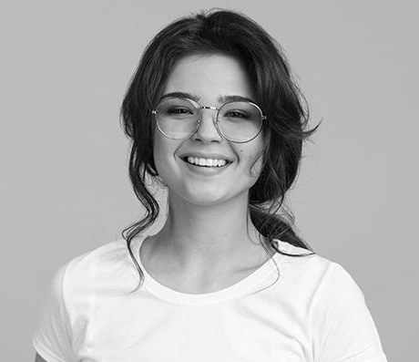
Reviews
Tom James
Jenna Doe
John Smith
Jessica Jones
Jupiter is the biggest planet of them all
Venus has a very beautiful name
Mercury is the smallest planet
Neptune is far away from Earth

Slide 48



2020 awards
Mercury
Venus
Mars
Mercury is the closest
planet to the Sun and the
smallest one
Venus has a beautiful name
and is the second planet
from the Sun
Despite being red, Mars is actually a cold place. It’s full
of iron oxide dust

Slide 49
04
Business model
Enter a subtitle here if you need it

Slide 50
Market size
Mercury
It’s the closest planet to the Sun
Mars
Despite being red, it’s cold
Venus
Venus has a beautiful name

Slide 51
Market size
20%
40%
Mercury
Venus
Mercury is the smallest planet
Venus has a beautiful name
30%
10%
Jupiter
Mars
Jupiter is the biggest planet
Mars is a very cold place

Slide 52
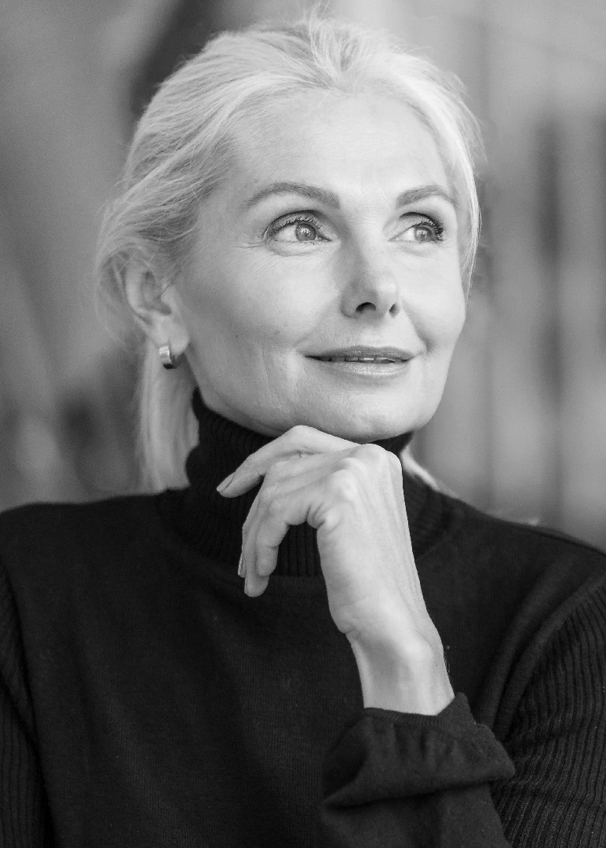
Our target
Job
Age
Interior Designer
50-60
Gender
Salary
Female
$15,000
Interests
Average spent
Shopping
$80,00
Reading
Trends

Slide 53
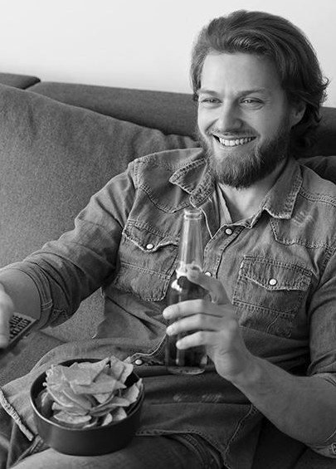
Our target
Job
Age
Informatic
35 - 45
Gender
Salary
Male
$12,000
Interests
Music
Sports
Dance
Sports

Slide 54

Buyer journey
Awareness
Jupiter is a gas giant and the biggest planet
Consideration
Mercury is the closest planet to the Sun
Decision
Venus has a beautiful name, but it’s terribly hot

Slide 55

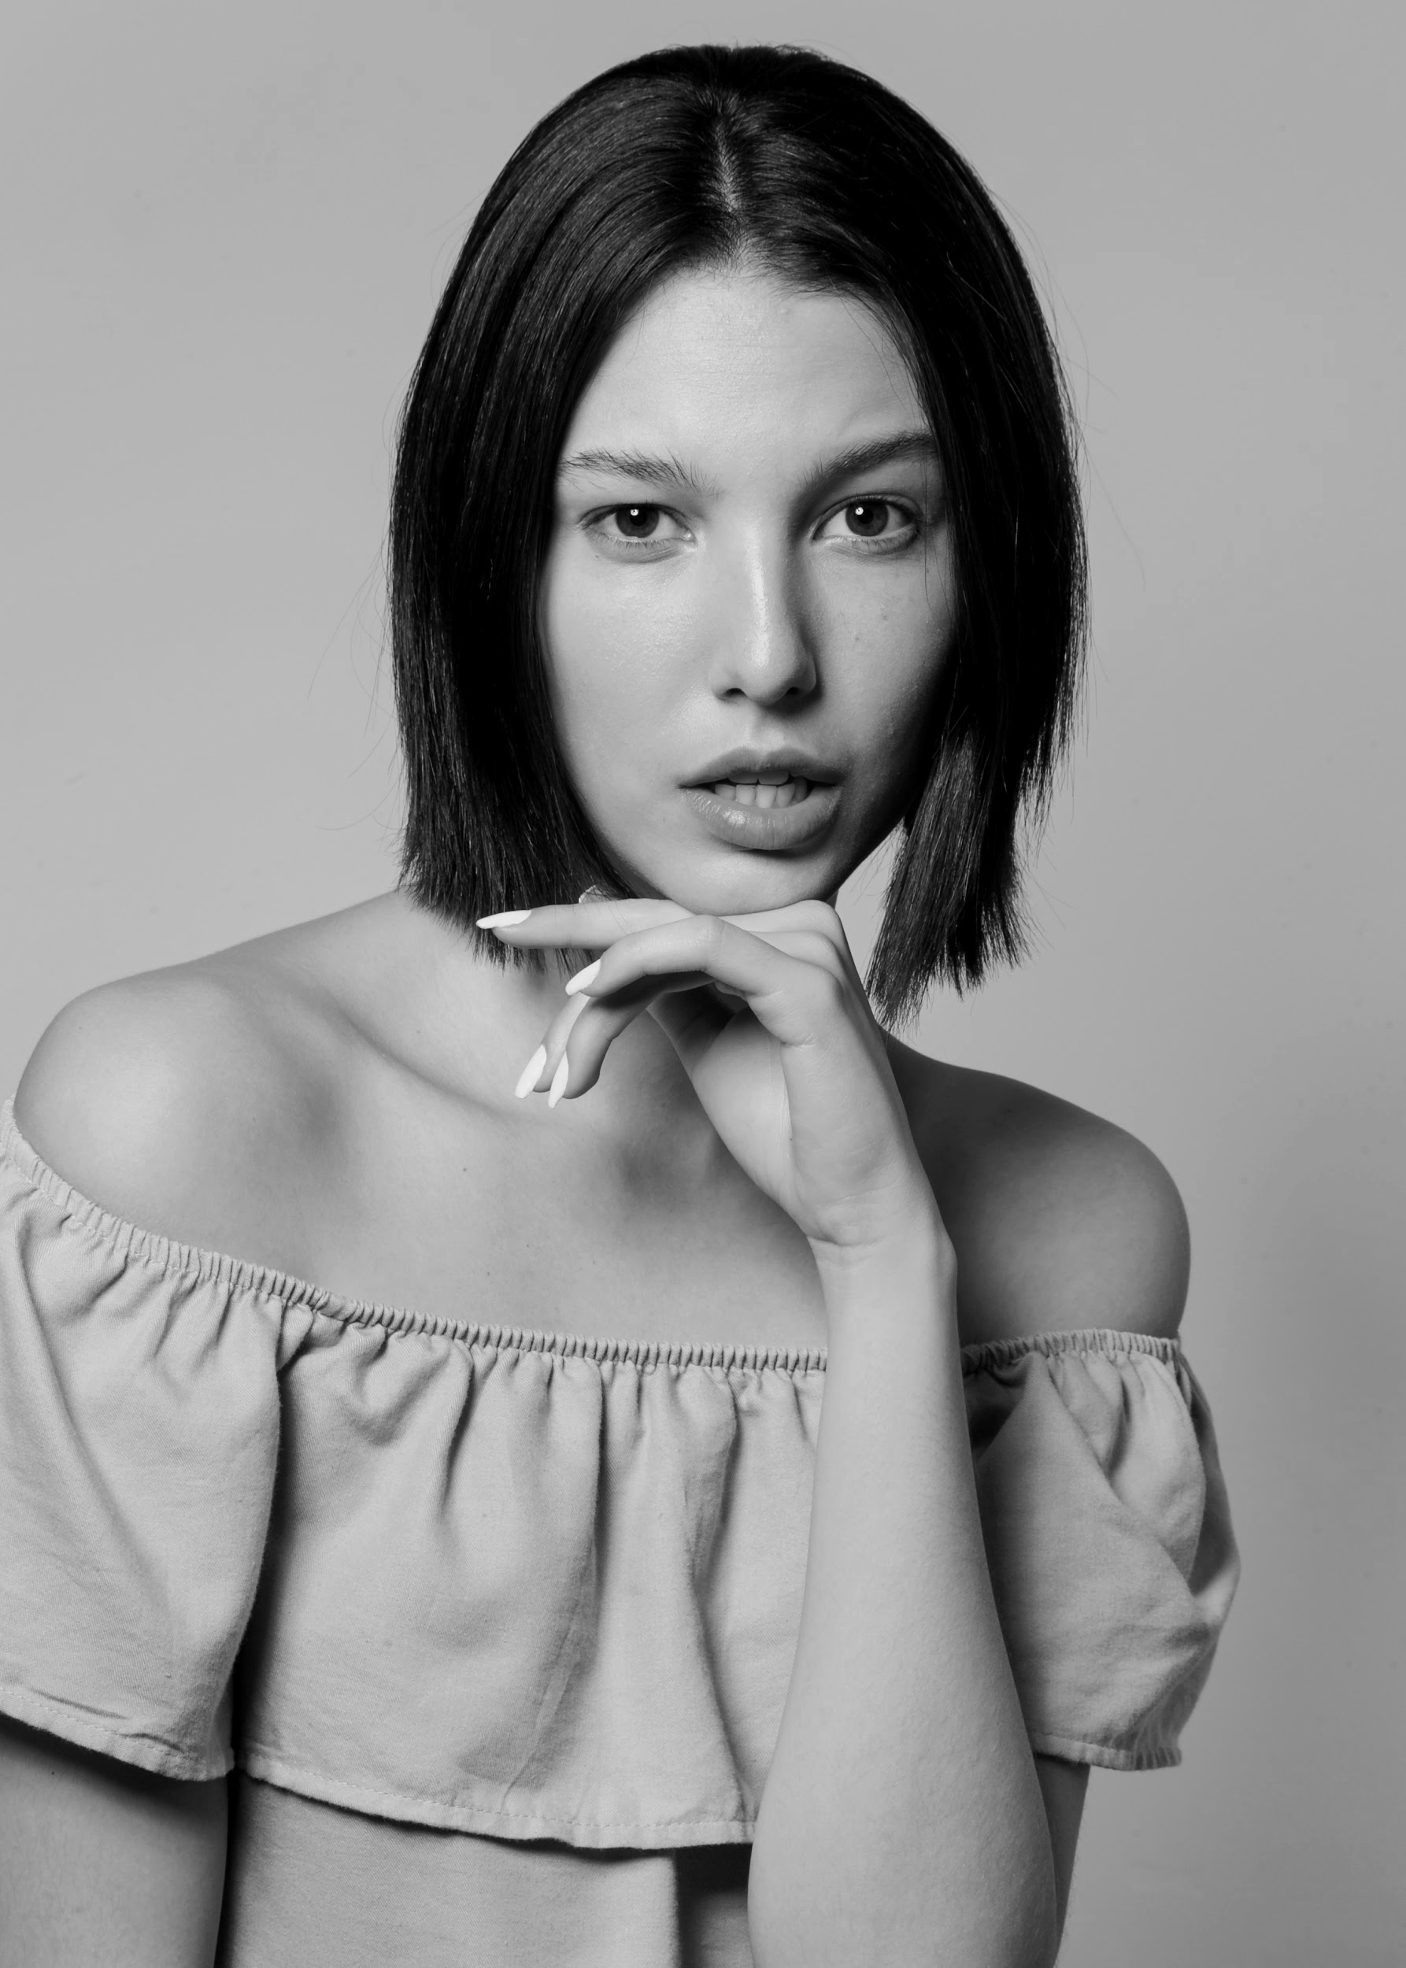

Competitors
Mars
Jupiter
Saturn
Despite being red, Mars is actually a cold place
Jupiter is a gas giant and the biggest planet of them all
Saturn is composed mostly of hydrogen and helium

Slide 56
Competitors
Venus
Jupiter
Venus is the second
planet from the Sun
Jupiter is a gas giant and the biggest planet
Saturn
Mars
Saturn is composed of hydrogen and helium
Despite being red, Mars is a cold place

Slide 57
Our business model
Marketing
Neptune is far away from us
Technology
Saturn is the ringed planet
Training
Mercury is a small planet
Assessment
Venus has a nice name

Slide 58
Our business model
Technology
MarketinG
Assessment
Training
Venus has a beautiful name, but it’s hot
Despite being red, Mars is a cold place
Mercury is the closest planet to the Sun
Jupiter is the biggest planet of them all

Slide 59
Schedule
Time | Mon | Tue | Wed | Thu | Fri
09:00 - 10:00 | Meeting | Home office | Home office
10:00 - 11:00 |  | Meeting |  | Brunch | Meeting
11:00 - 11:30 |  |  | Project | Meeting
11:30 - 12:30 |  | Accounting
12:30 - 13:30 | Project |  |  | Meeting | Project
13:30 - 14:30 | Lunch | Lunch | Lunch | Lunch | Lunch
14:30 - 15:30 | Accounting |  | Meeting

Slide 60
Competitor analysis
 | Mars | Venus | Mercury | Jupiter
Despite being red, Mars is a cold place
Venus has a beautiful name, but it’s hot
Mercury is the closest planet to the Sun
Jupiter is the biggest planet of them all

Slide 61
Predicted growth
20,000
100
500
Expected customers
New employees
Upcoming projects

Slide 62
Predicted growth
25%
50%
75%
Venus
Mars
jupiter
Venus has a beautiful name, but it’s hot
Despite being red, Mars is a cold place
Jupiter is the biggest planet of them all

Slide 63
333,000
9h 55m 23s
386,000 km
earths is the Sun’s mass
is Jupiter’s rotation period
is the distance between Earth and the Moon

Slide 64
$90,000
Expected income

Slide 65
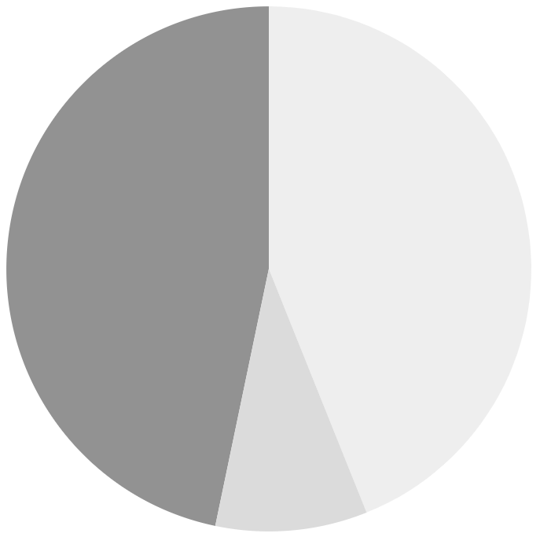
Investment
45%
Mercury
Mercury is the closest planet to the Sun
Mars
10%
Despite being red, Mars is a cold place
45%
Jupiter
Jupiter is the biggest planet of them all
To modify this graph, click on it, follow the link, change the data and paste the new graph here

Slide 66
Investment
25%
50%
75%
mercury
MARS
JUPITER
Mercury is the closest planet to the Sun
Despite being red, Mars is a cold place
Jupiter is the biggest planet of them all

